Slide 1
Brief Introduction of Huju Brand Bar Binder
Hu Ju brand bar strapping machine is a kind of automatic packaging equipment which integrates machine, electricity and liquid. It is specially used for packing equipment of finished products of rolling mill (bar and section) in metallurgy industry.
According to knotting pass form is divided into single-winding, double-wound, according to the material is divided into the type of tying materials, bar-type and other forms.
Hu Ju brand bar baler packaging quality is the best, can replace imports. The machine failure rate is low (less than one thousandth), long spare parts life, production and operation costs low (0.3 yuan / ton). The machine into the market in 2013, as the year 2015 has sold more than 200 units, well received by users.
Companies adhering to the "needs of users is our pursuit of" business philosophy. And constantly blaze new trails, technology as the core, depending on the quality of life, from the user to God and dedication to provide you with cost-effective metallurgical products, high-quality engineering design and dedicated and thoughtful service. Welcome domestic and foreign merchants to visit the company cooperation.

Slide 2
Description of baling machine model

Slide 3
Binding machine technical parameters
Name of baler | Single and Double Winding Machines for Small Bars | Large double - wound baler | Large single - winding baler in the big bar | Single - wound strapping machine
Strapping machine model | HJLD(S)400/200-6.5 | HJBS500/200-6.5 | HJBD500/200-8 | HJXD650-6.5/8
Bundle diameter | φ200～φ400 | φ200～φ400 | φ200～φ400 | φ200～φ400
Bale weight | 1.5～4Ton | 2～5Ton | 2～5Ton | 2～5Ton
Bundle diameter | φ6.5Hot rod | φ6.5Hot rod | φ8Hot rod | φ6.5/φ8Hot rod
Binding wire material | Q195 | Q195 | Q195 | Q195
Release mechanism | Have | Have | No | Have
Binding mode | Single-winding single-knot, double-winding single knot | Double - wound single knot | Single winding single junction | Single winding single junction
Bale shape | Round, oval | Round, oval | Round, oval | Square, rectangular
Rolling diameter or shape | Small bars or rebars | In the large bar | In the large bar | Profiles
Rolling length | Length4m～12m | Length4m～12m | Length4m～12m | Length4m～12m
Rolling temperature | ≤300℃ | ≤300℃ | ≤300℃ | ≤300℃
Strapping a cycle | 8～12秒 | 8～12秒 | 8～12秒 | 8～12秒
Dimensions (mm) | 3600×1250×2050 | 3600×1250×2050 | 3600×1250×2050 | 3600×1250×2050
equipment weight | 5Ton | 5Ton | 5Ton | 5Ton
Working temperature | 0～40 | 0～40 | 0～40 | 0～40
Installed capacity | 16KVA | 16KVA | 18KVA | 16/18KVA
control method | PLC automatic (S7-200 / 300) / manual, with the production line, communication function
power supply | Three-phase four-wire AC380V + PE50Hz
Hydraulic system | Pressure rating 8 ~ 12MPa \ air-cooled

Slide 4
Key Features of Huju Brand Bar Strapping Machine
（1）The use of fuel tank tightening, tightening force, into a bundle of good quality, to prevent the lifting of the process of loose bundles of transport phenomenon.
（2）Bundled materials using ordinary hot-rolled wire rod, without any treatment, easy procurement, the use of low cost.
（3）The wire-twisting mechanism adopts the patented compound hydraulic cylinder mechanism exclusively, and is installed on the body of the car body which moves along the oblique 45 ° track. Through the positioning device, the tweezers can be kept in proper positional relationship with the bundled steel, without any adjustment. Adapt to different bundle diameter. Screw twisting action of the spiral side of the forward movement, does not produce additional stress to ensure that the steel bundle tight and not easy to loose bundles.
（4）The bundling machine has a kink after the end of the device, the binding end of the flat close to the steel bundle, so that a more beautiful and reliable bundle, kinks should not scraping touch, kink-forming is good, easy roller conveyor and loose bundle.
（5）Adopting cylinder pressure wire device, it is simple and convenient to wear wire; press wire adopts two-wheel mechanism, and the hot-rolled wire rod is stable.

Slide 5
Key Features of Huju Brand Bar Strapping Machine
（6）Wear wire slot hanging installation, hot-rolled wire rods can be automatically out of iron oxide; not easy to block, smooth wire.
（7）The hydraulic system pipeline adopts the precision galvanized seamless steel pipe, the hydraulic cylinder seal all adopts the import seal, has effectively guaranteed the hydraulic system cleanliness, has reduced the system leakage, lengthened the system service life.
（8）Bundle body located in the roller track on the side of the base track, equipped with travel device can easily enter and exit the roller, easy offline debugging and maintenance.
（9）The guide wire slot is composed of upper and lower arms, which can be arranged on the special packing roller table. It can also be arranged on the outside of the manual baling roller table to adapt to the special circumstances such as the old line transformation.
（10）Tiger Ju brand bundling machine with "mechanical and electrical integration design", easy to install, as long as the user provides 380V three power interface can be.

Slide 6
Bar baler appearance display

Slide 7
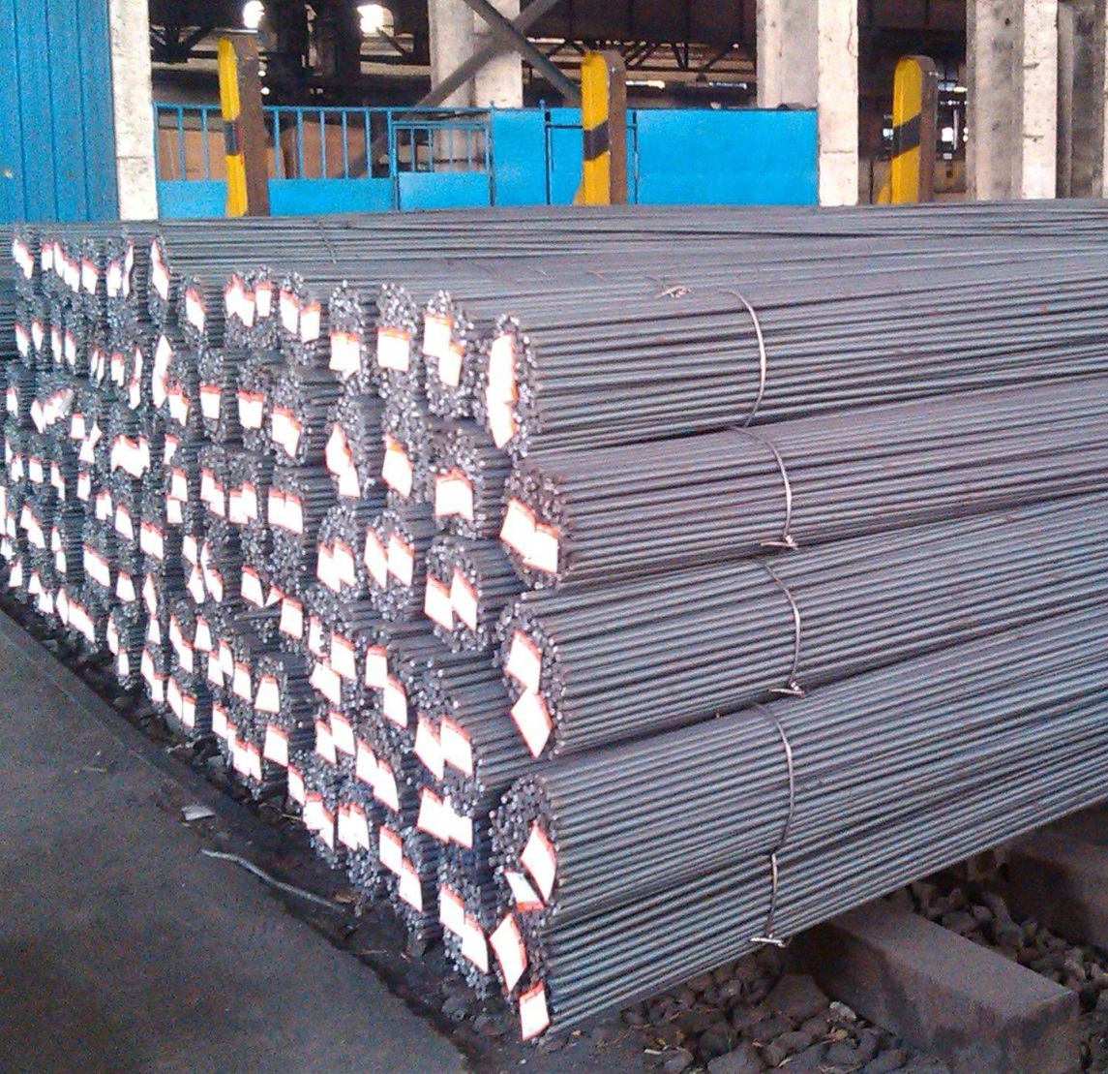
Bar bale finished product renderings show

Slide 8
Profile baling machine appearance display

Slide 9
Profiles of finished product bale renderings show

